Slide 1
Interrupt & Polling
Jannatun Naher

Slide 2
How A Computer React to Inputs?
Polling: the processor regularly looks at the input and react accordingly
Easy to implement and debug
Intensive processing
If an event is rare, CPU wastes lots of time checking
Processor can’t go into low-power mode
Interrupt: the processor is “interrupted” by an event
Time effective
Energy saving: processor can be asleep most of time
Hard to debug

Slide 3
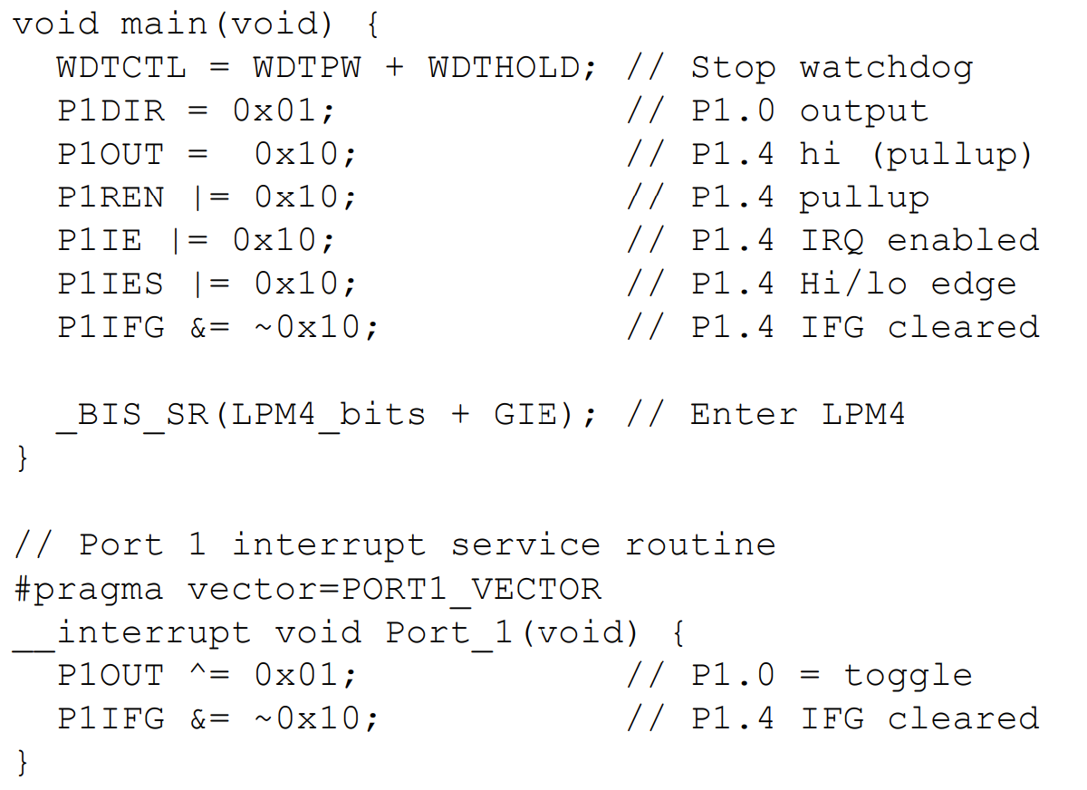
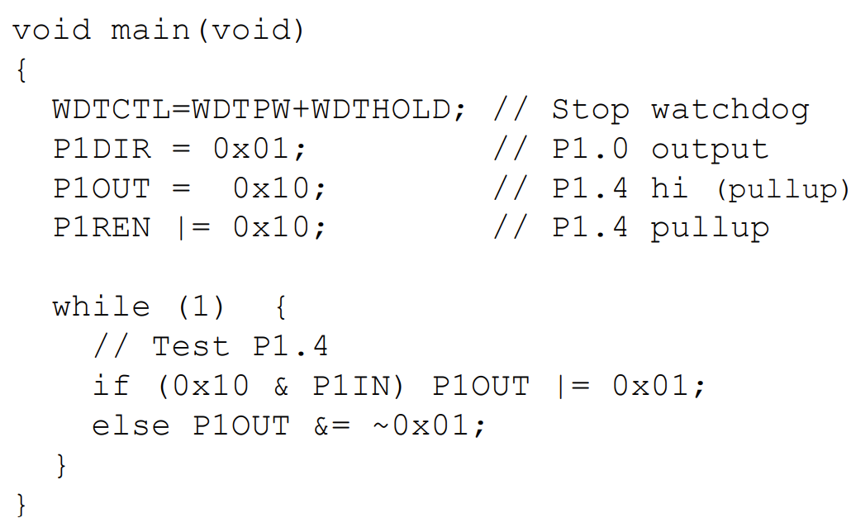
Polling vs Interrupt

Slide 4
Polling

Slide 5
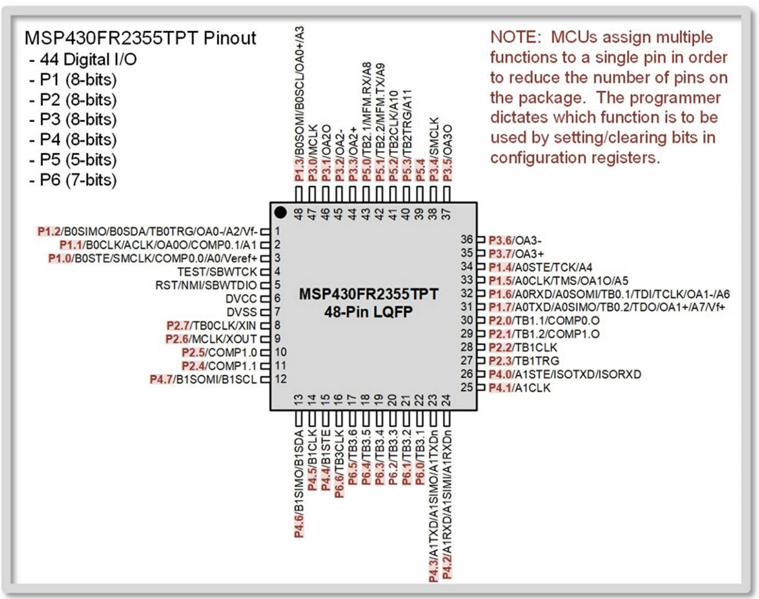

Slide 6
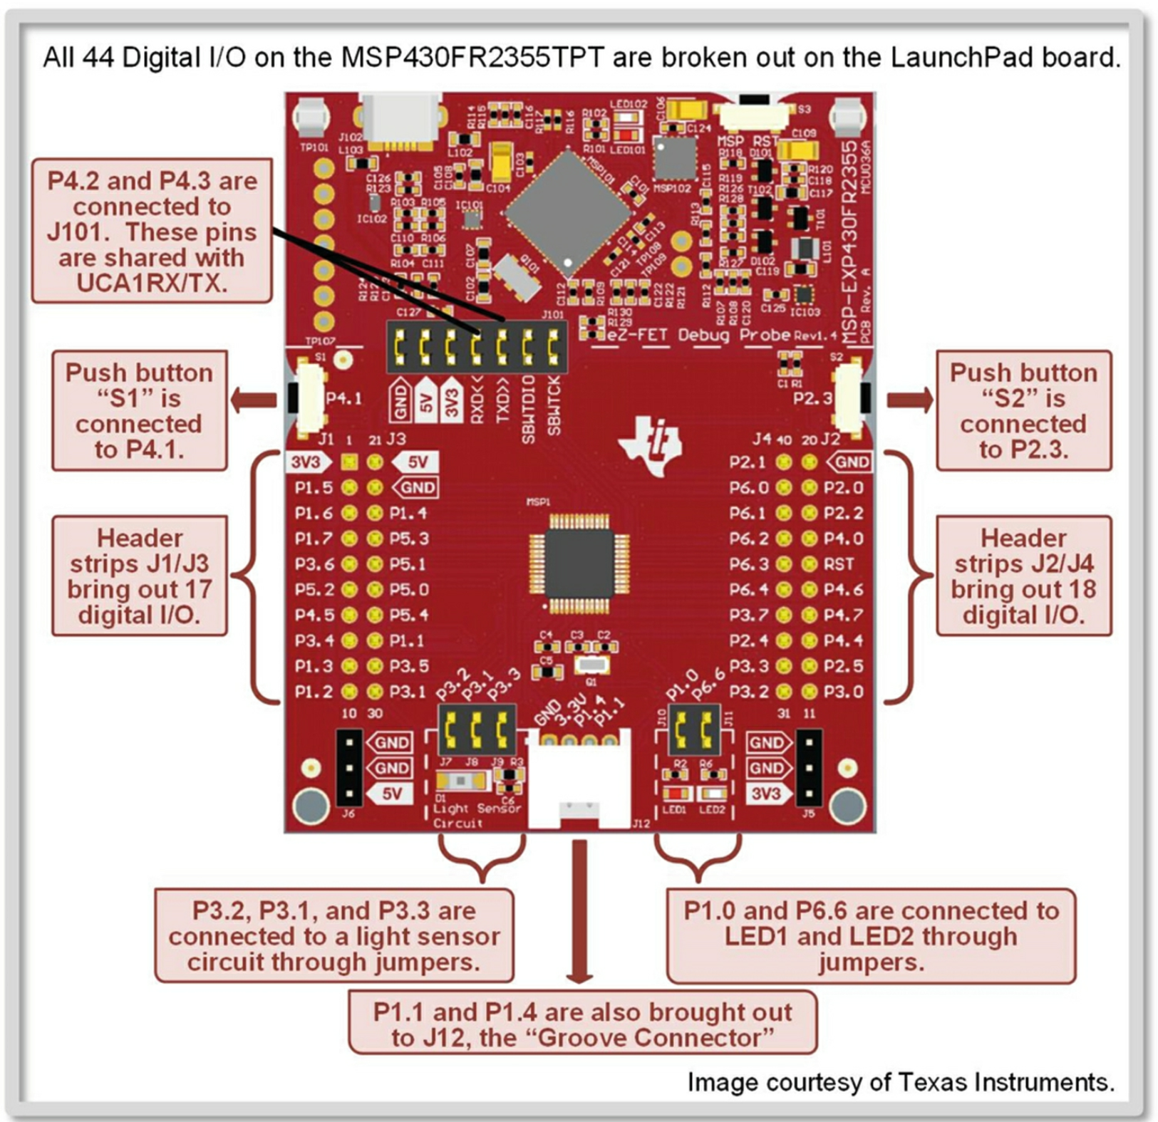

Slide 7
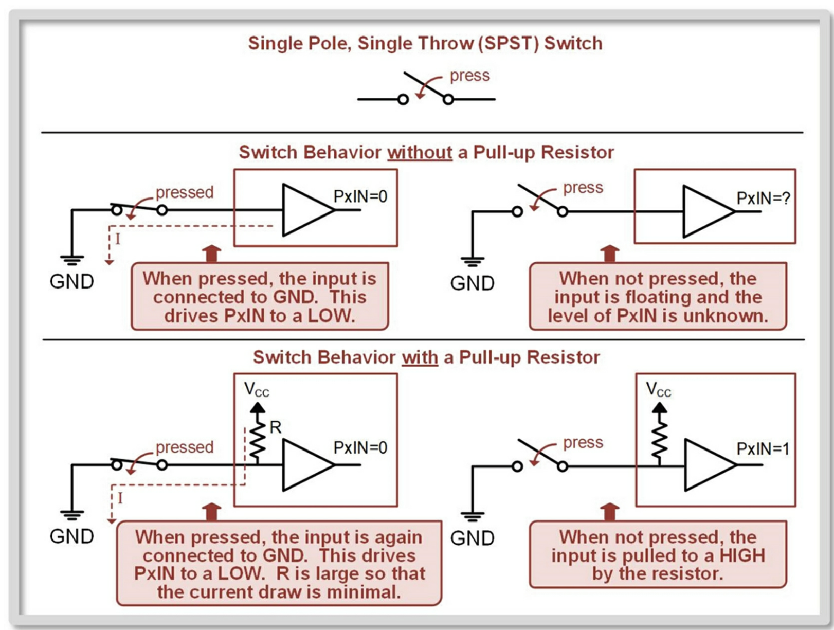
Pull-up/Pull-down resistor

Slide 8
Pull-up/Pull-down resistor
Whether or not a port input has a pull-up/pull-down resistor is dictated by the bits within the PxREN register.
The bits within PxREN control the corresponding bit location within PxIN (i.e., bit 0 of PxREN controls whether bit 0 of PxIN has a pull-up/pull-down resistor).
The logic for PxREN is as follows:
Bit = 0: Pull-up/pull-down resistor disabled (default).
Bit = 1: Pull-up/pull-down resistor enabled.
When PxREN enables a pull-up/pull-down resistor, the PxOUT register is used to dictate whether the resistor is a pull-up or pull-down.
If PxDIR = 0, making the port bit an input, and PxREN = 1, enabling the pull-up/pull-down resistor, then the PxOUT register has the following logic:
PxOUT = 0: Insert a pull-down resistor.
PxOUT = 1: Insert a pull-up resistor.

Slide 9
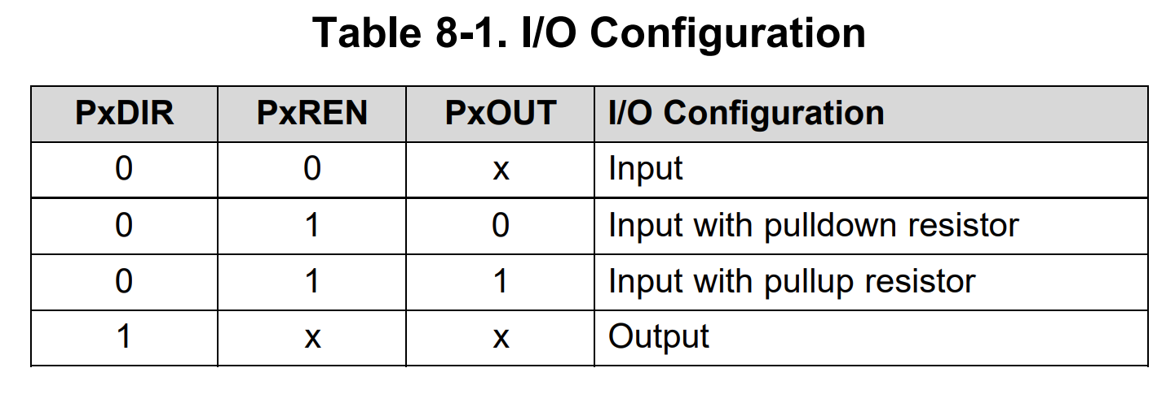
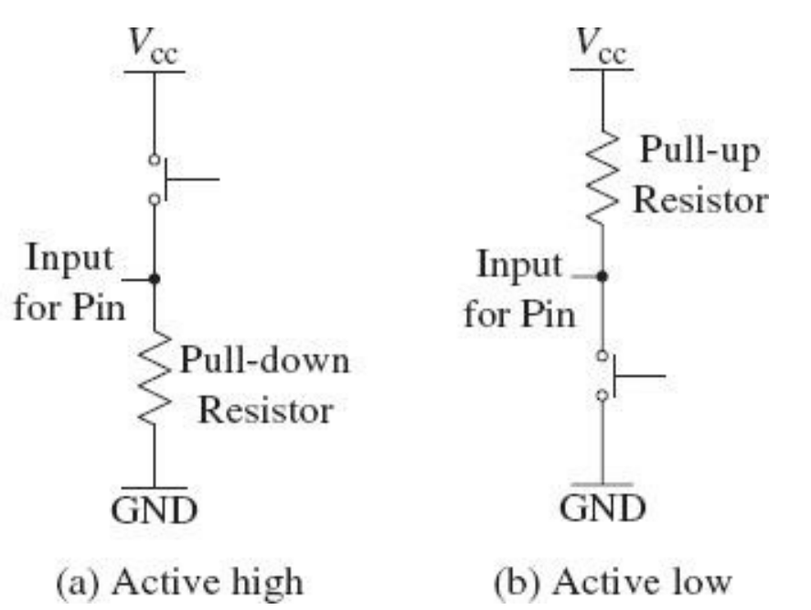
MSP430FR2355 works preferably in active low mode, so for input PxREN = 1, PxOUT = 1

Slide 10
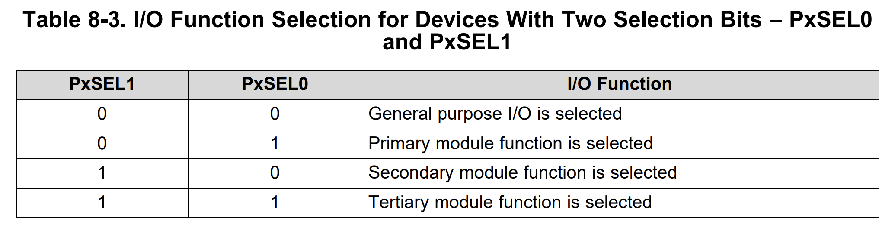

Slide 11
Digital I/O Enabling After Reset
Initialize Configuration Registers: PxDIR, PxREN, PxOUT if applicable, and PxSEL1:PxSEL0.
Clear the LOCKLPM5 bit in the PM5CTL0 register.
Your program may now start using the PxIN or PxOUT registers.

Slide 12
Digital Output Programming
Initialize Configuration Registers: - P1DIR bit 0 = 1 ; Configure P1.0 as an OUTPUT Note: For an output, this is all we need to do (relying on PxSEL1:PxSEL0 = 00).
bis.b #BIT0, P1DIR ; Set P1.0 as an output. P1.0 = LED1 bic.b #LOCKLPM5, PM5CTL0 ; Disable Digital I/O low-power default

Slide 13
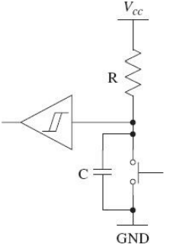
Switch Debouncing
Switch debouncing in an electronic design ensures that the device that is sampling the switch waveform does not misinterpret a single button press as many. Push button Switch Circuit and Voltage Waveform.
Software solution (add delays)
Hardware solution (low pass RC filter)

Slide 14
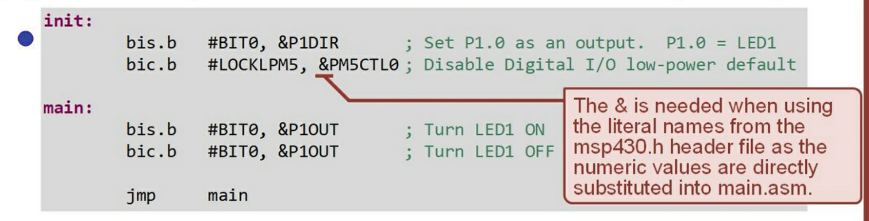
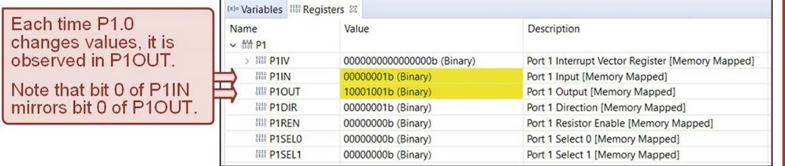
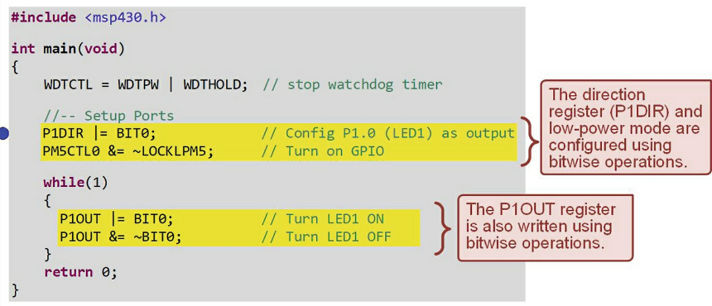
Blinking LED1

Slide 15
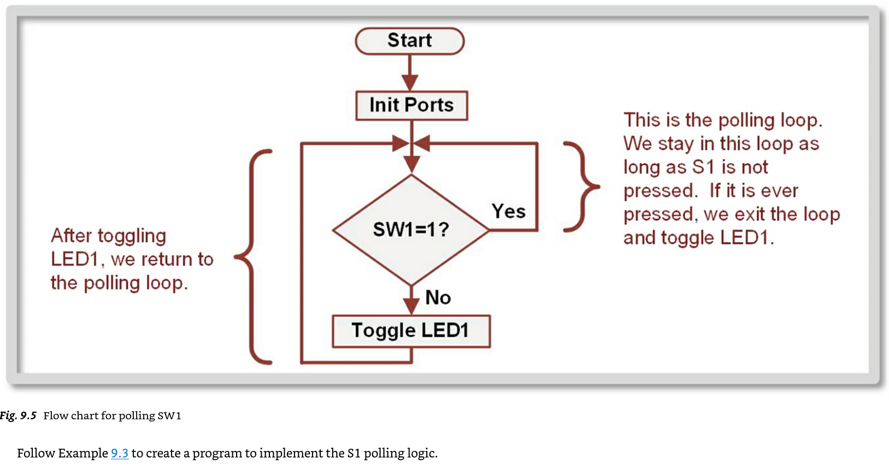

Slide 16
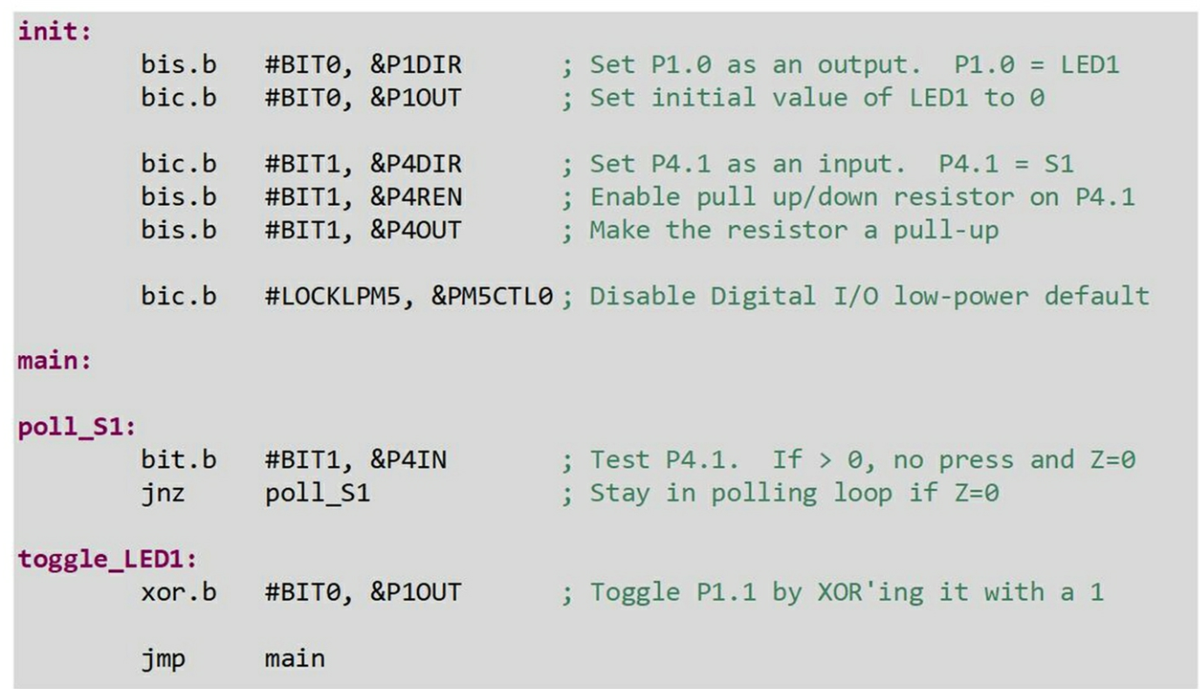
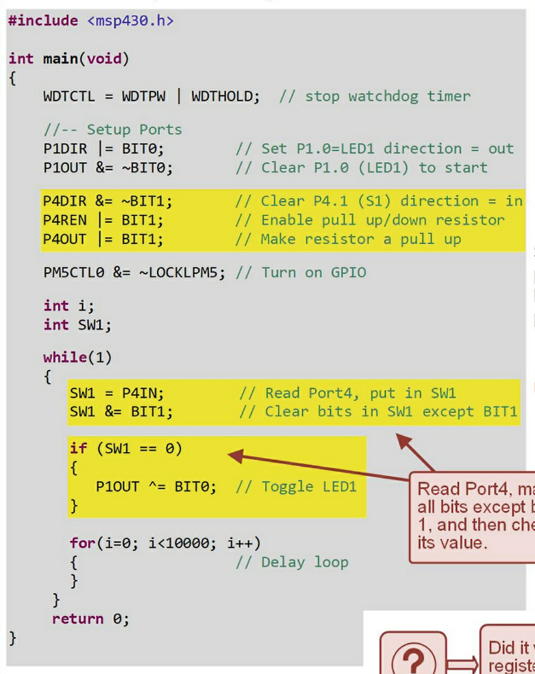
Polling the input S1

Slide 17
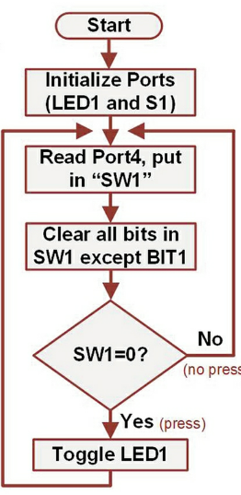
Polling the input S1

Slide 18
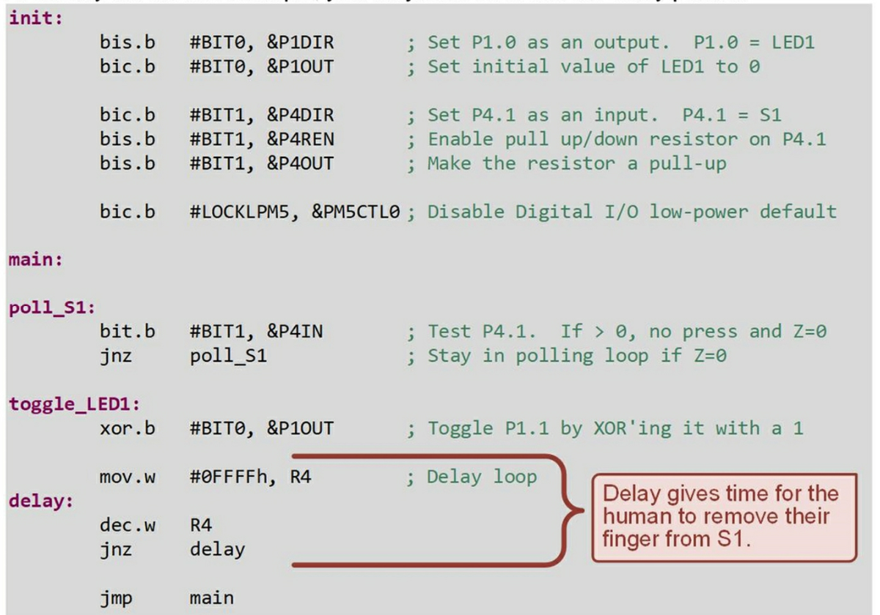
Polling the input S1 with Delay

Slide 19
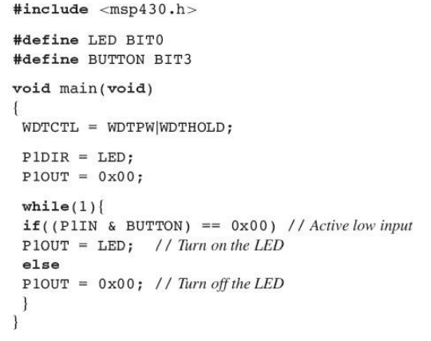
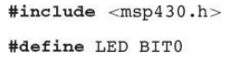
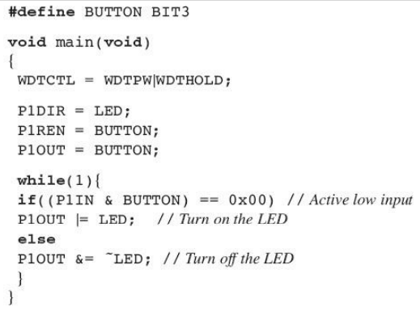
Turning on the red LED when the push button is pressed, for MSP430 LaunchPad
Using pull-up resistors

Slide 20
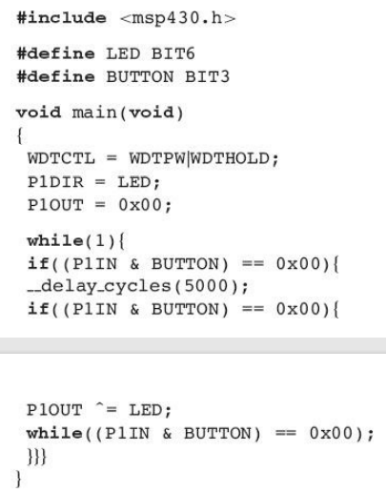
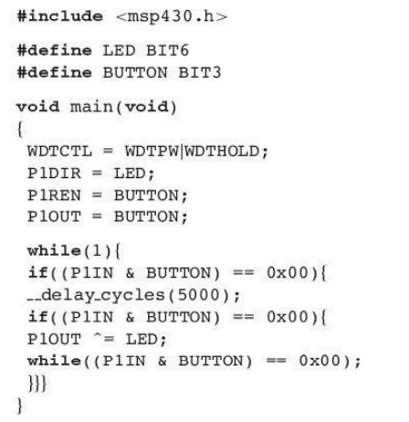
Toggling the green LED when the push button is pressed (with software solution)
Using pull-up resistors

Slide 21
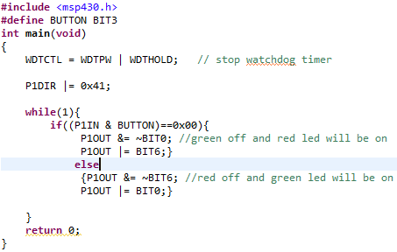
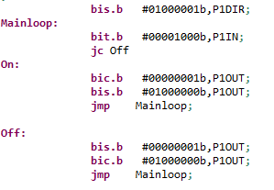
Turns the red and green LEDs on and off based on the status of the button pressed
C code
Assembly code

Slide 22
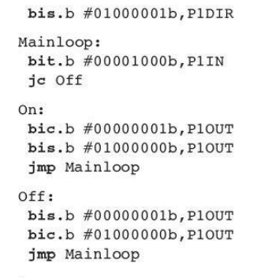
Turns the red and green LEDs on and off based on the status of the button pressed
P1DIR = 0X41, set bits in the destination
if((P1IN & BUTTON) == 0x00), test bits in the destination
Jump to label if the carry bit is set
P1OUT &= ~BIT0; clear bits in the destination
P1OUT |= BIT6; set bits in the destination
P1OUT |= BIT0; set bits in the destination
P1OUT &= ~BIT6; clear bits in the destination

Slide 23
Exercise#1
Using CCS C configure PORT 1 for digital I/O with Pins 5~6 outputs and Pins 0~3 inputs
Read in from properly configured PORT1 Pins 0~3. Depending on the reading in values, set Pins 5~6.

Slide 24
Interrupts

Slide 25
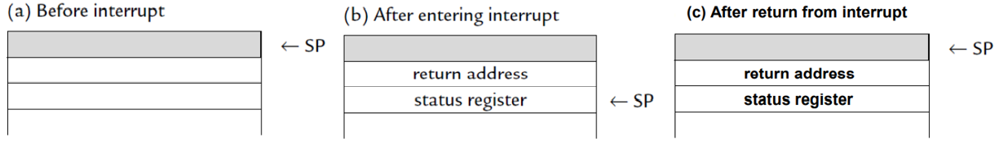
What Happens When an Interrupt Occurs?
Processor stops what it is doing
Stores enough information to later resume
Executes an interrupt service routine (ISR)
Restores saved information
Resumes execution

Slide 26
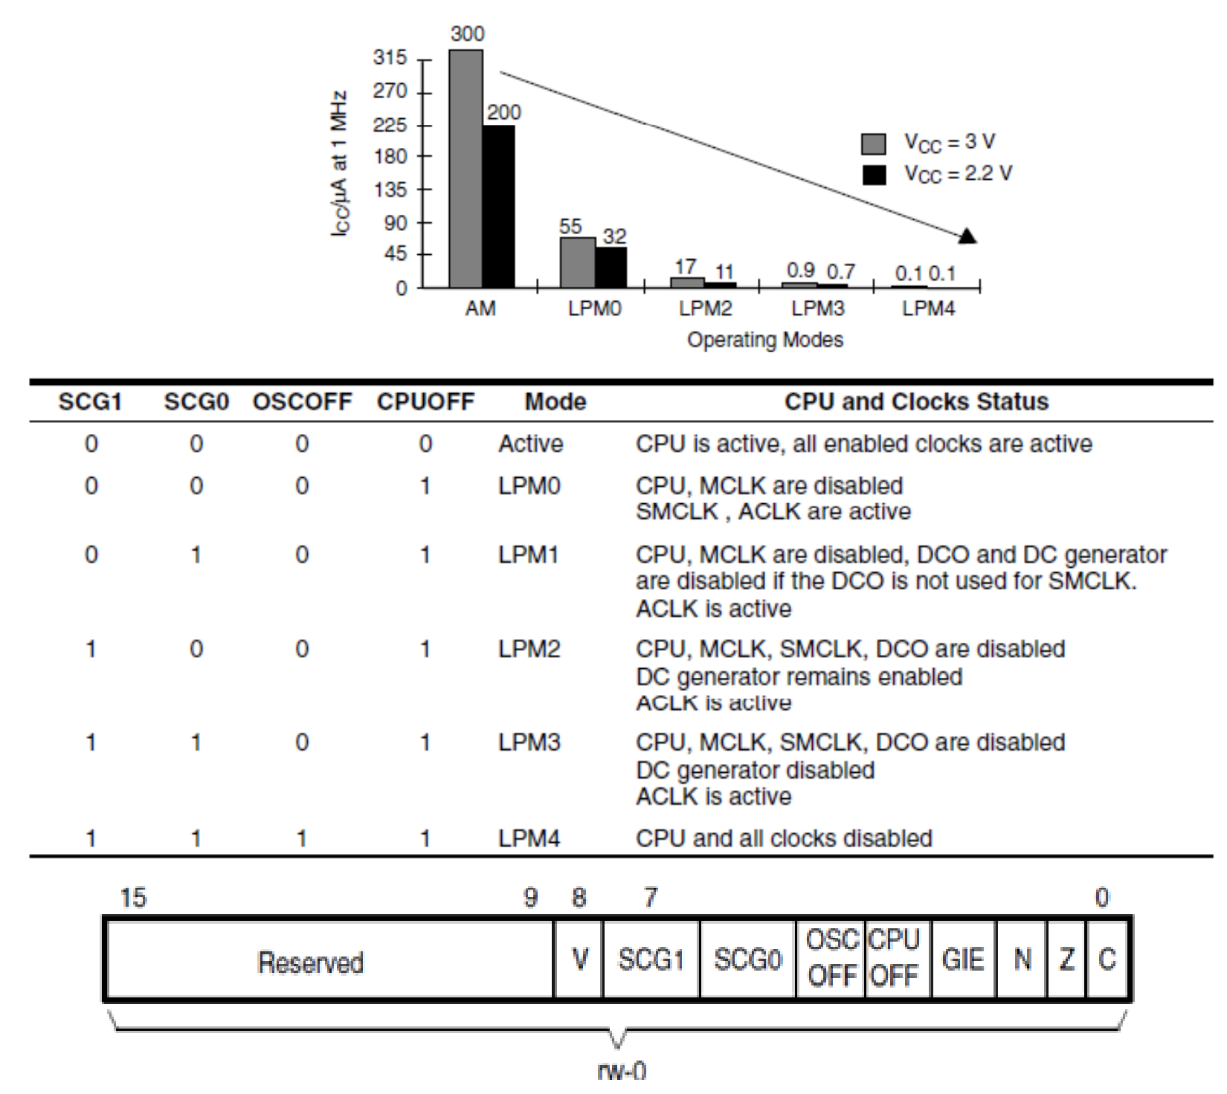
Operating modes

Slide 27
three types of interrupts for MSP430
Reset-has highest priority
Maskable- can only occur when the GIE bit in the status register (R2) is set to 1 & the local interrupt is enabled. Most interrupts on the MSP430 fall into this category. GPIO, timers and peripherals all generate interrupts that can be masked by the GIE bit.
Non-maskable- can occur whenever the associated event occurs. It is used for things that can not afford to be ignored. Typically, these are fault handlers such as oscillator faults and flash access violation which indicate a critical condition.
can’t be suppressed by clearing GIE
It also require bits to be set/clear
in special function or peripheral registers to enable/disable

Slide 28
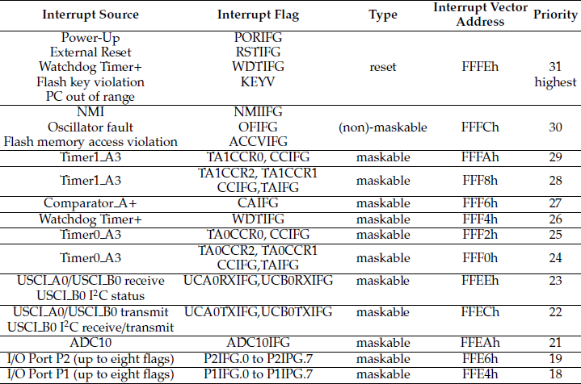
Interrupt Flags

Slide 29
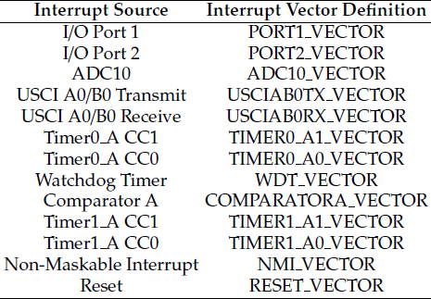
Interrupt Vectors
The CPU must know where to fetch the next instruction following an interrupt.
The address of an ISR is defined in an interrupt vector.

Slide 30
Interrupt Service Routines
An ISR cannot be written entirely in standard C, because there is no way to identify it as an ISR rather than an ordinary function.
Two additions are needed to the ISR:
The #pragma line, which associates the function with a particular interrupt vector.
The __interrupt keyword at the beginning of the line that names the function.
An intrinsic function is needed to set the Global Interrupt Enable (GIE) bit and turn on interrupts.
This function is called as __enable_interrupt().
It is declared in msp430g2553.h, therefore it must be included.

Slide 31
Port Interrupts
Each pin of ports P1 and P2 can make an interrupt request
Pins are configured with additional registers for interrupts:
Interrupt Enable (PxIE):
Read-write register to enable interrupts on individual pins;
PxIE configuration:
Bit = 1: The interrupt is enabled;
Bit = 0: The interrupt is disabled.
Each PxIE bit enables the interrupt request associated with the corresponding PxIFG interrupt flag;
Taken from MSP430 Teaching ROM Texas Instruments 2009

Slide 32
Port Interrupts
Interrupt Edge Select Registers (PxIES):
Selects the transition on which an interrupt occurs (if PxIE and GIE are set);
PxIES configuration:
Bit = 1: Interrupt flag is set on a high-to-low transition;
Bit = 0: Interrupt flag is set on a low-to-high transition.
Interrupt Flag Registers (PxIFG)
Set automatically when an the programmed signal transition (edge) occurs;
PxIFG flag can be set and must be reset by software.
PxIFG configuration:
Bit = 0: No interrupt is pending;
Bit = 1: An interrupt is pending.
Taken from MSP430 Teaching ROM Texas Instruments 2009

Slide 33
Interrupt Service Routines
ISR in C language
ISR in assembly language
;---------------------
P1_ISR ;ISR definition
bic.b #08h,P1IFG ;Clear the P1.3 interrupt flag
reti ;Return from the ISR
;---------------------
;ISR Code to be Added Here
//Main Code Block to be Added Here
#pragma vector=PORT1_VECTOR //define the interrupt vector
__interrupt void PORT1_ISR(void){ // Interrupt Service Routine
//ISR Code to be Added Here
P1IFG = 0x00; //clear the interrupt flag
}

Slide 34
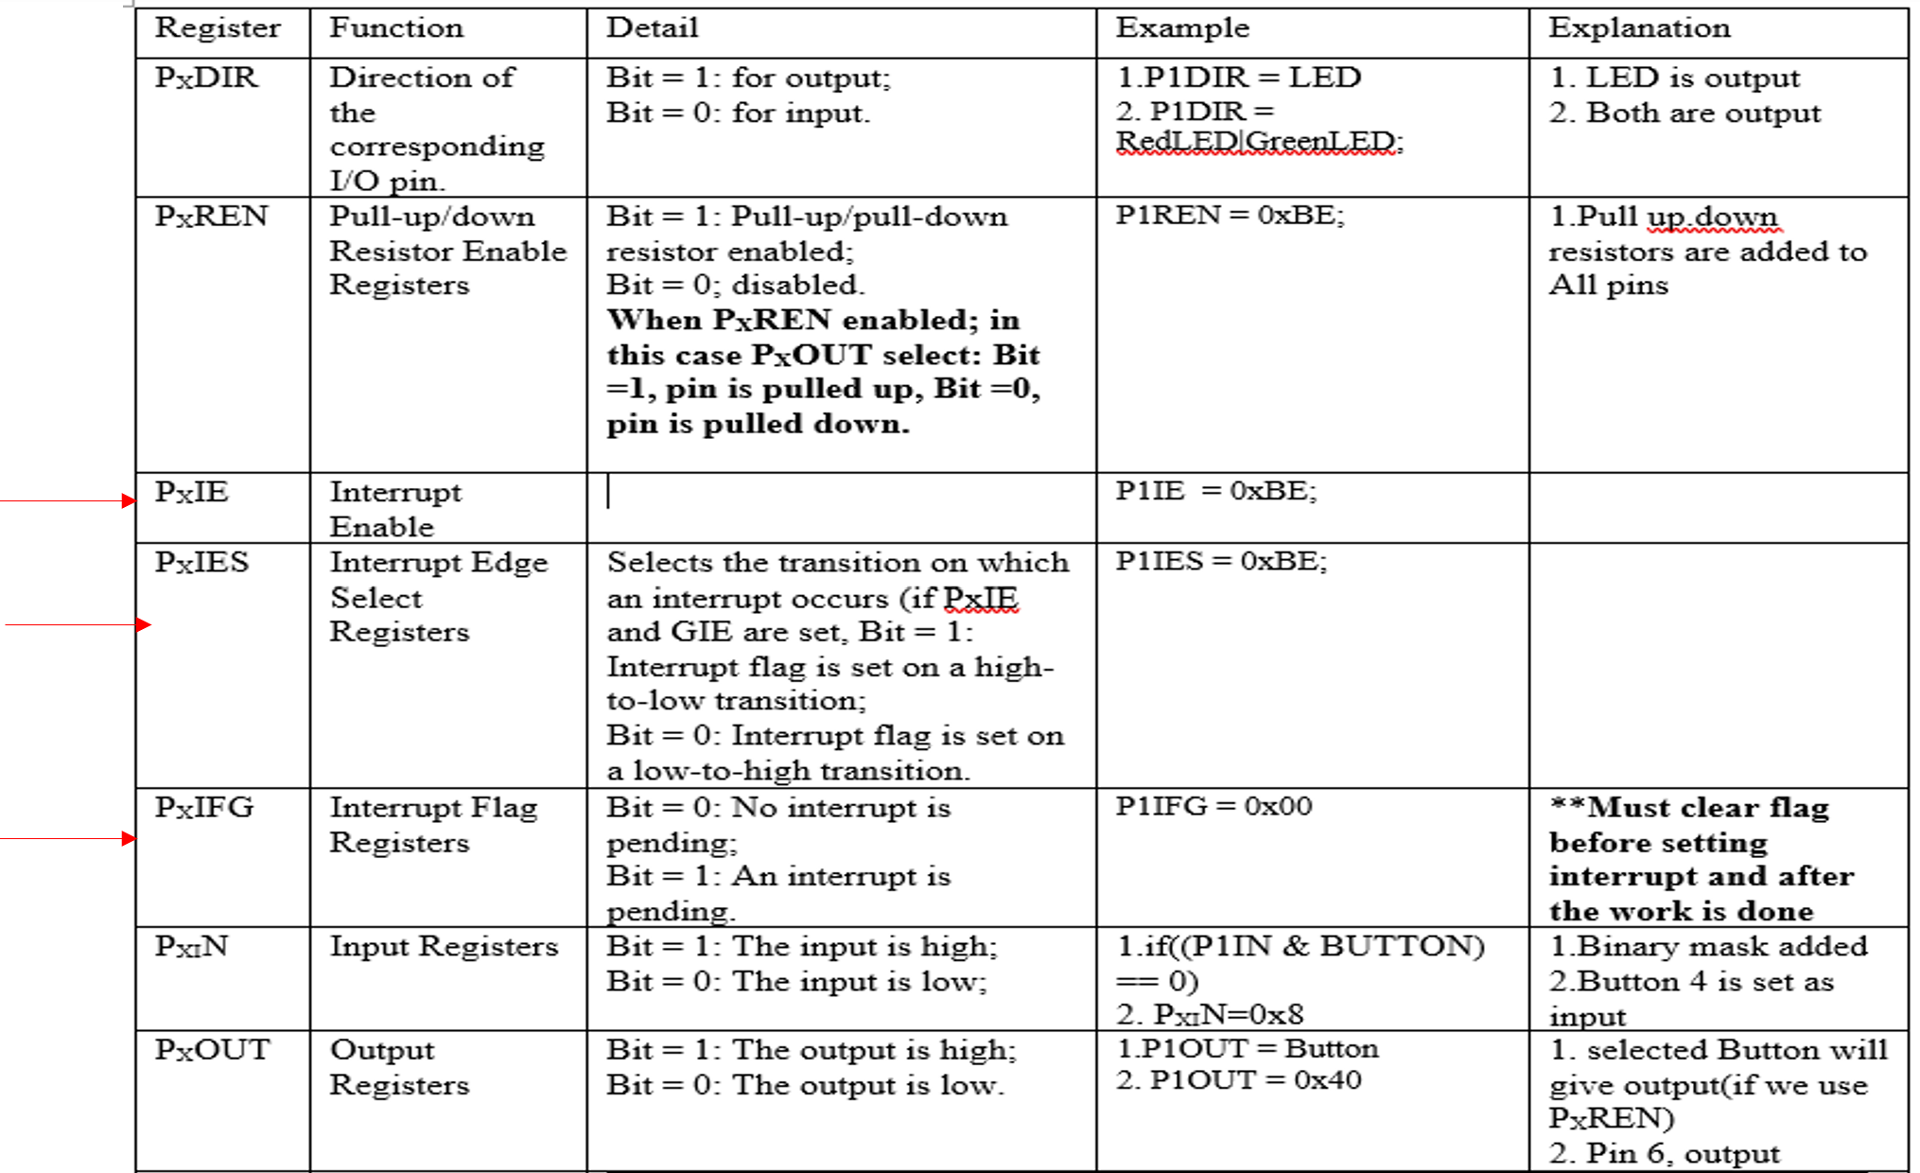

Slide 35
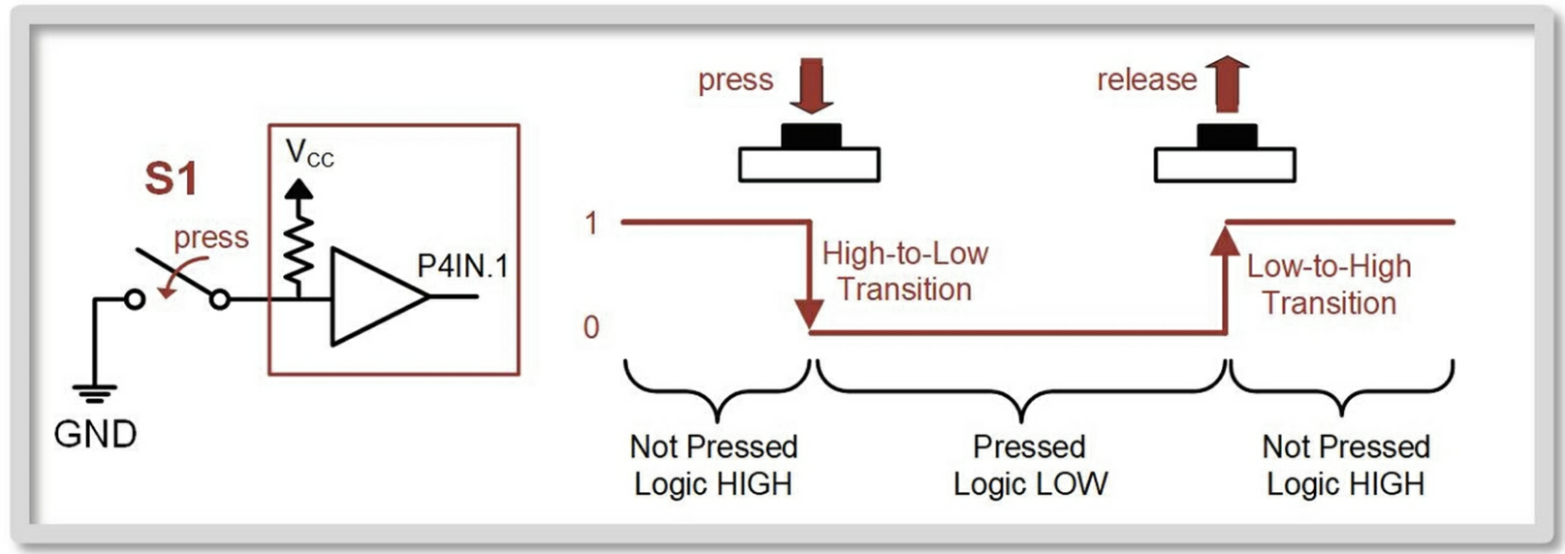
A graphical depiction of the logic levels and transitions that occur when S1 is pressed and released.
Initialize the port direction (PxDIR), pull-up/down resistor (PxREN), the pull-up/down resistor polarity (PxOUT), and the port interrupt edge select (PxIES ).
Clear LOCKLPM5 bit. Clear the port interrupt flags (PxIFG ) for first use.
Note that the reset value for PxIFG=00h, but often bits will be asserted inadvertently due to step 1.
Assert the local port interrupt enable (PxIE ). Assert the global enable for maskable interrupts (GIE bit in SR).
Let’s now look at configuring the push-button switch S1 on the LaunchPad™ board to trigger a port interrupt. Let’s design a program that will toggle LED1 each time S1 is pressed using an interrupt.
First, let’s look at the signal behavior of S1 when pressed.

Slide 36
A few things to keep in mind when setting up a push-button interrupt:
S1 is connected to Port4, bit 1. While the logic level of S1 can be observed on P4IN.1, when using an interrupt, we don’t have to look at this bit. We instead allow a transition to assert an interrupt flag and have the CPU execute an ISR accordingly.
S1 is an SPST switch that is connected to ground. This means we need a pull-up resistor on the MCU to provide the logic HIGH state when S1 is not pressed.
If we want the IRQ to trigger immediately upon a button press, then we need to configure the interrupt edge sensitivity (P4IES.1) to be high-to-low. When S1 is not pressed, P4.1 is at a logic high. When the button is pressed, P4.1 goes to a logic low. If we leave the P4IES.1 sensitivity at its default value of low-to-high sensitivity, the interrupt will only trigger once S1 is released (we’ll look at this behavior in a following example).
.

Slide 37
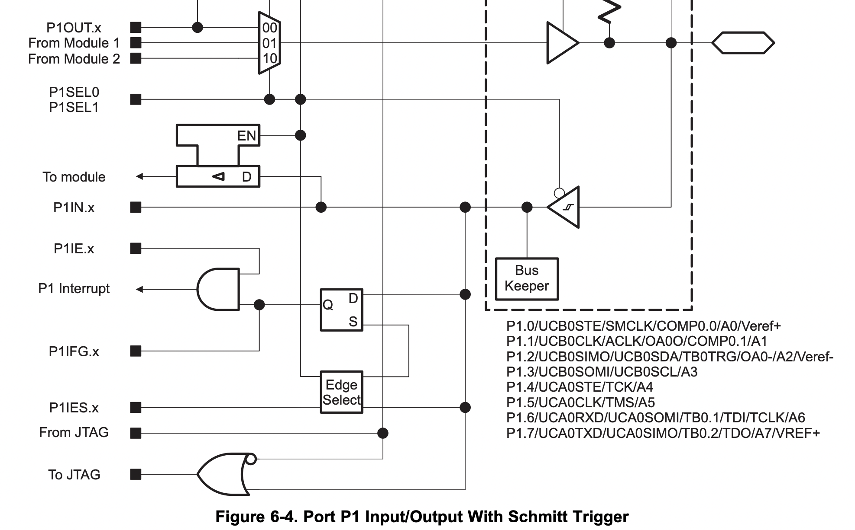
(1)
(2)
(3)

Slide 38
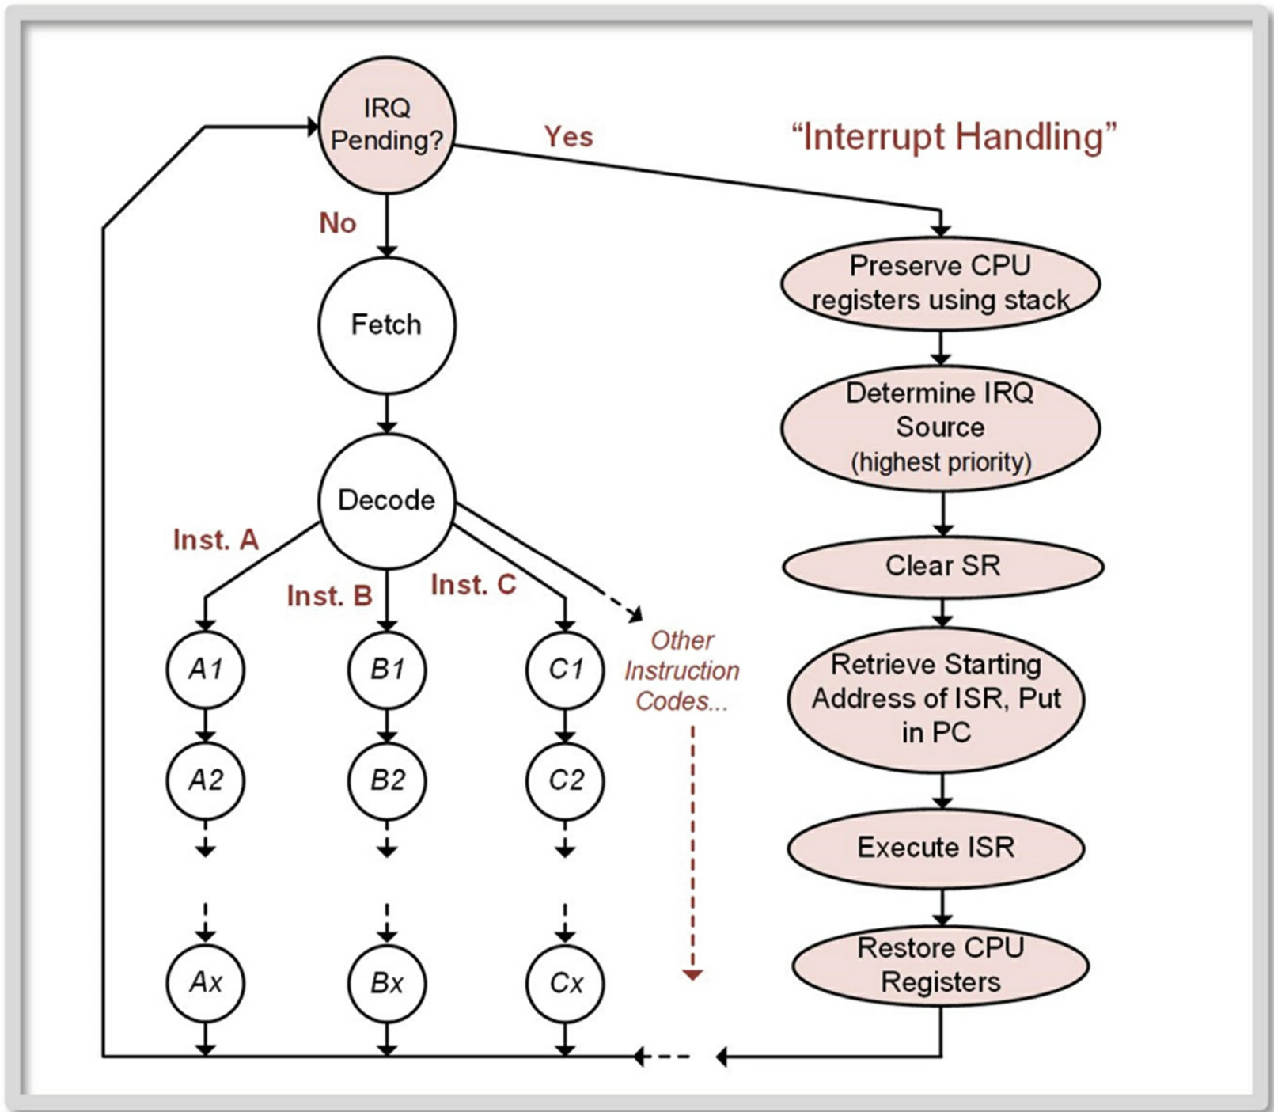

Slide 39
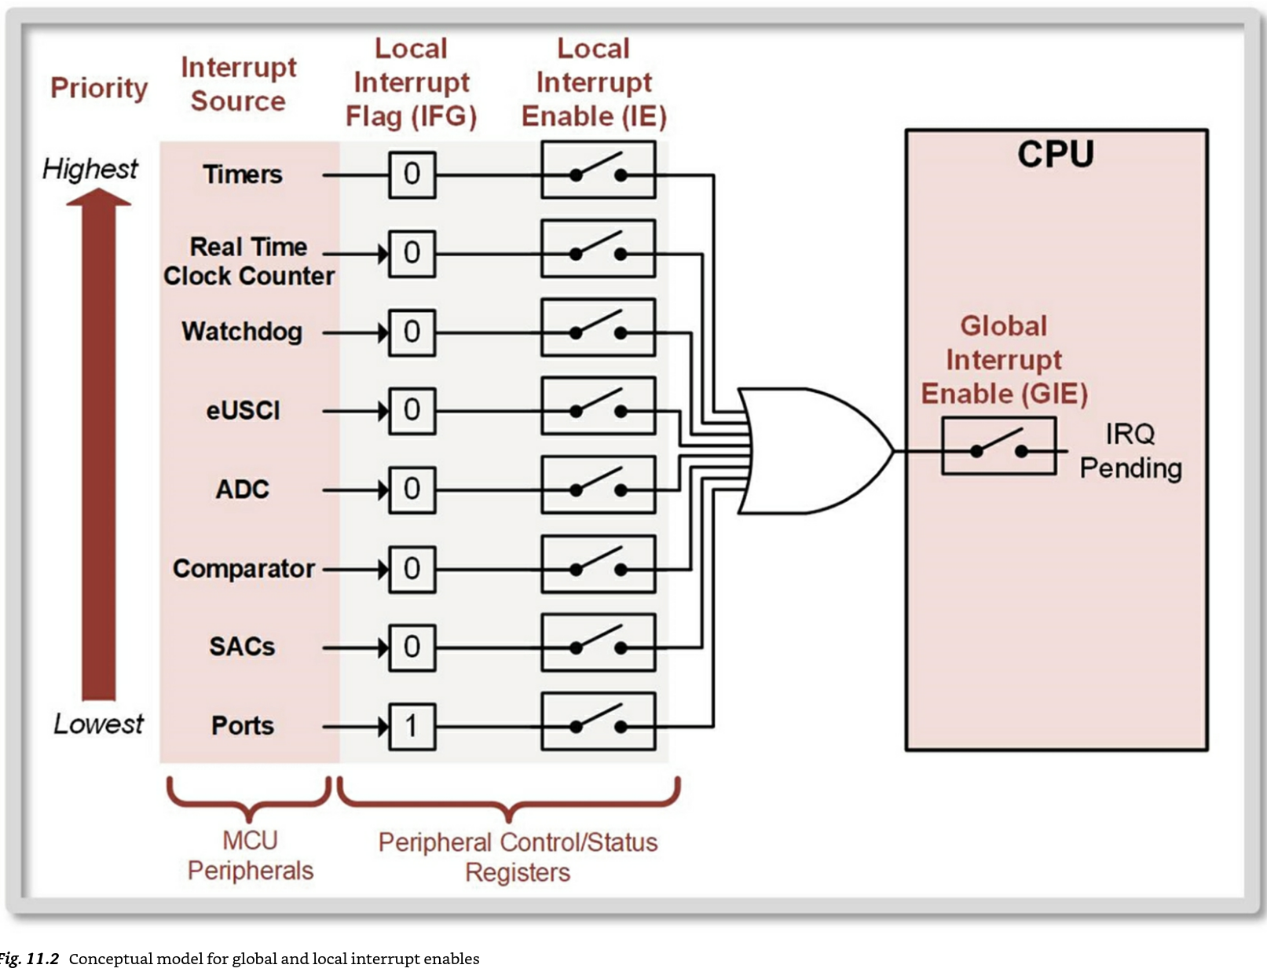

Slide 40
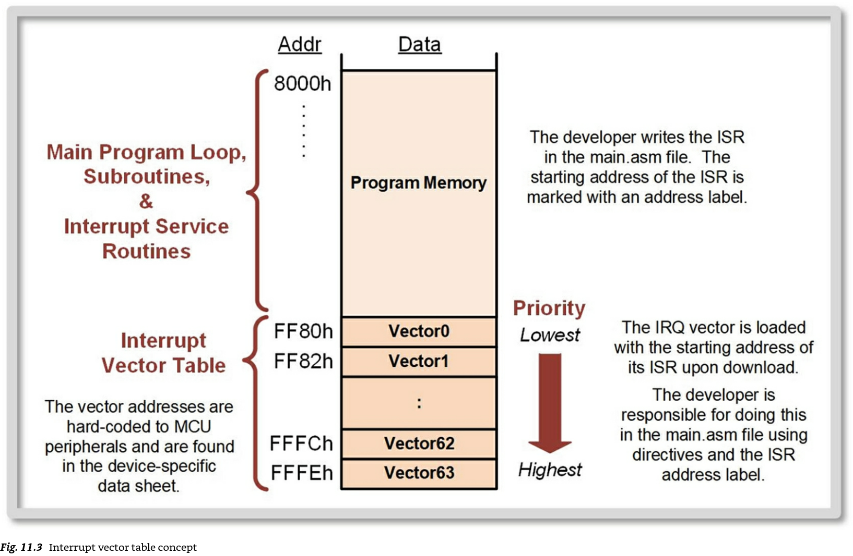
Interrupt Vectors

Slide 41
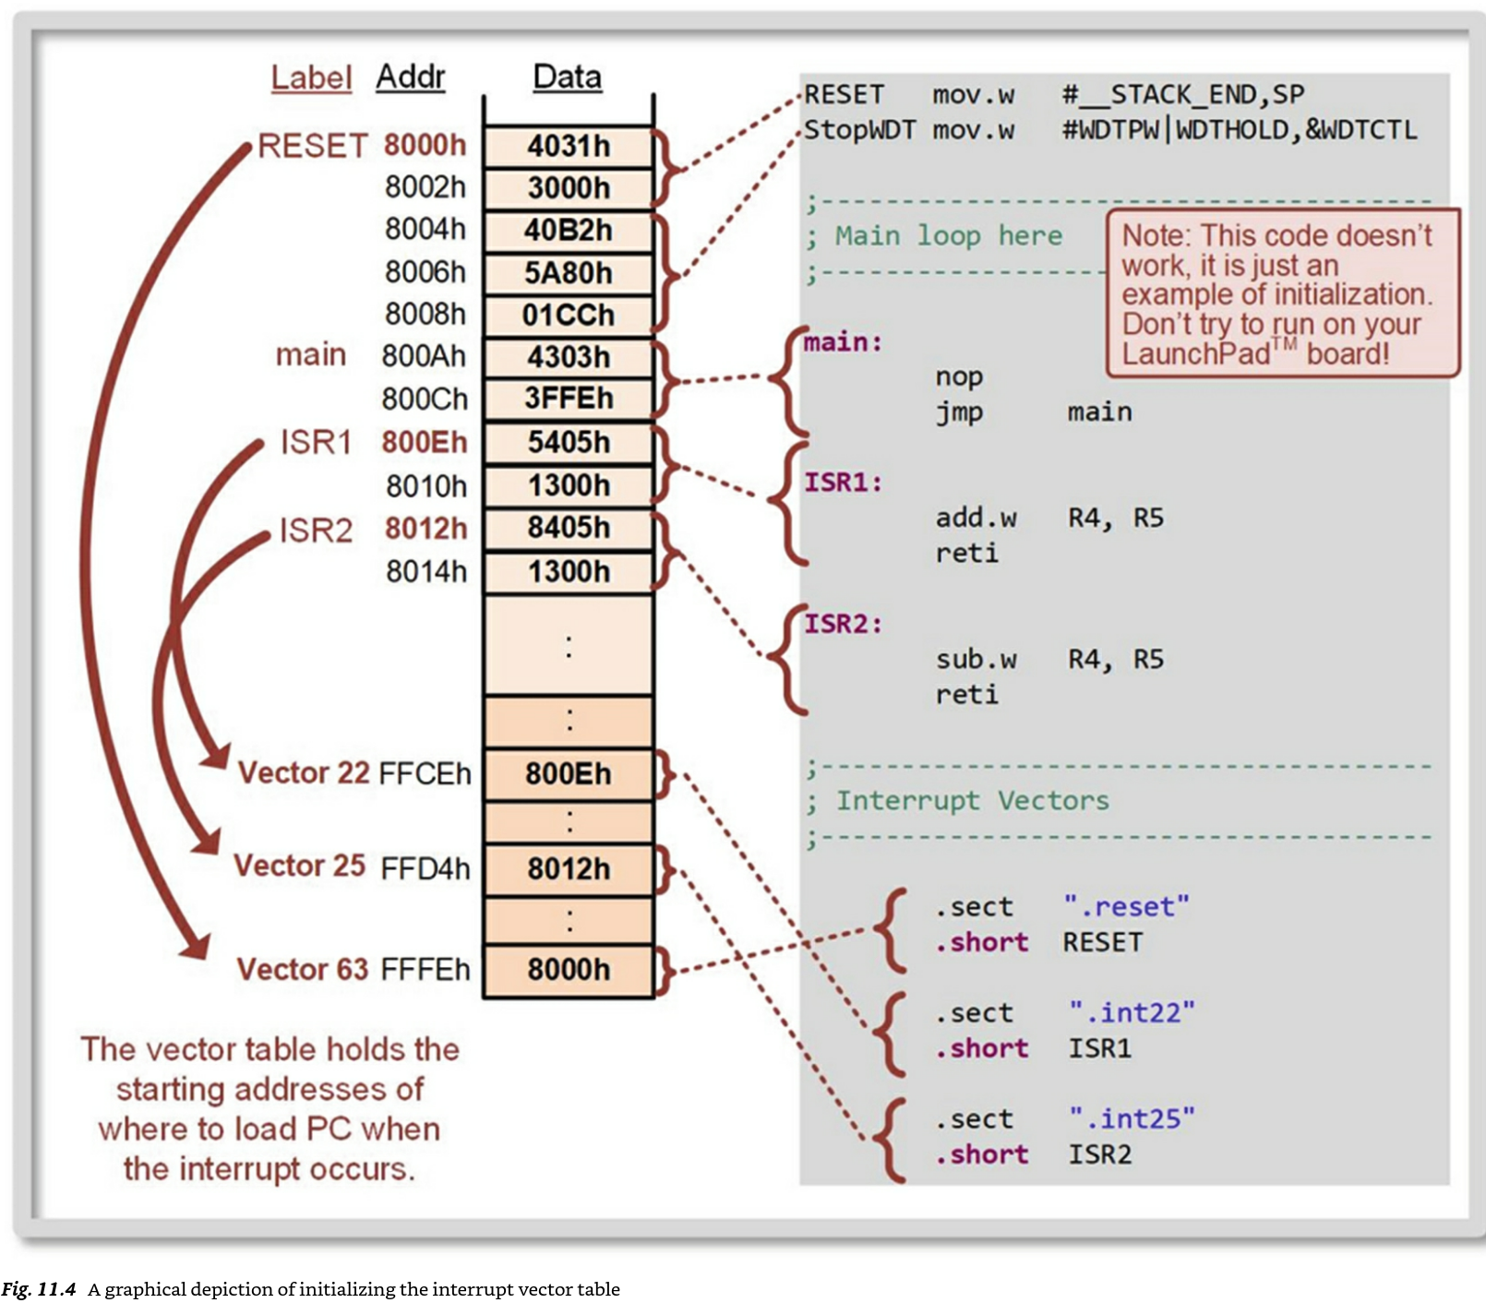

Slide 42
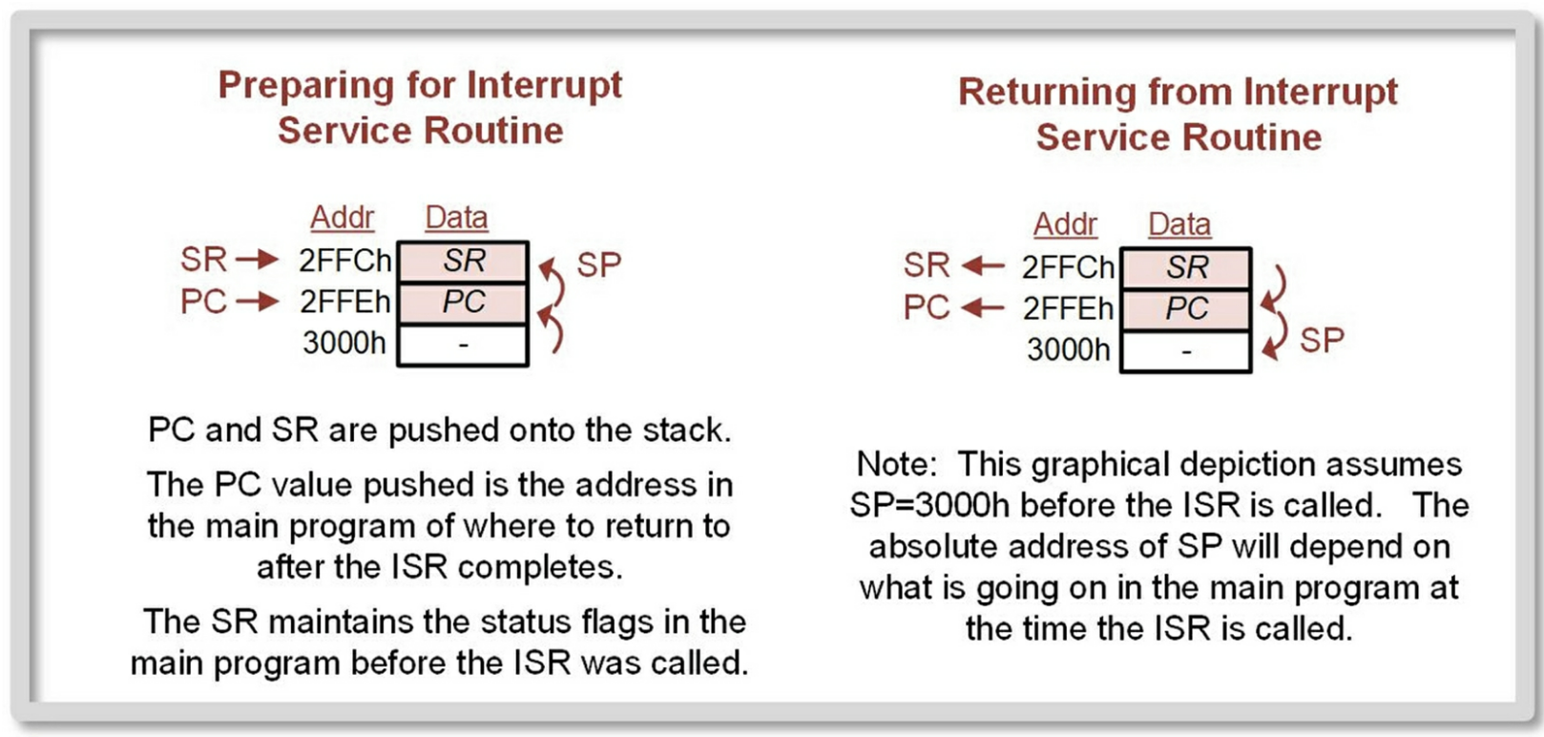

Slide 43
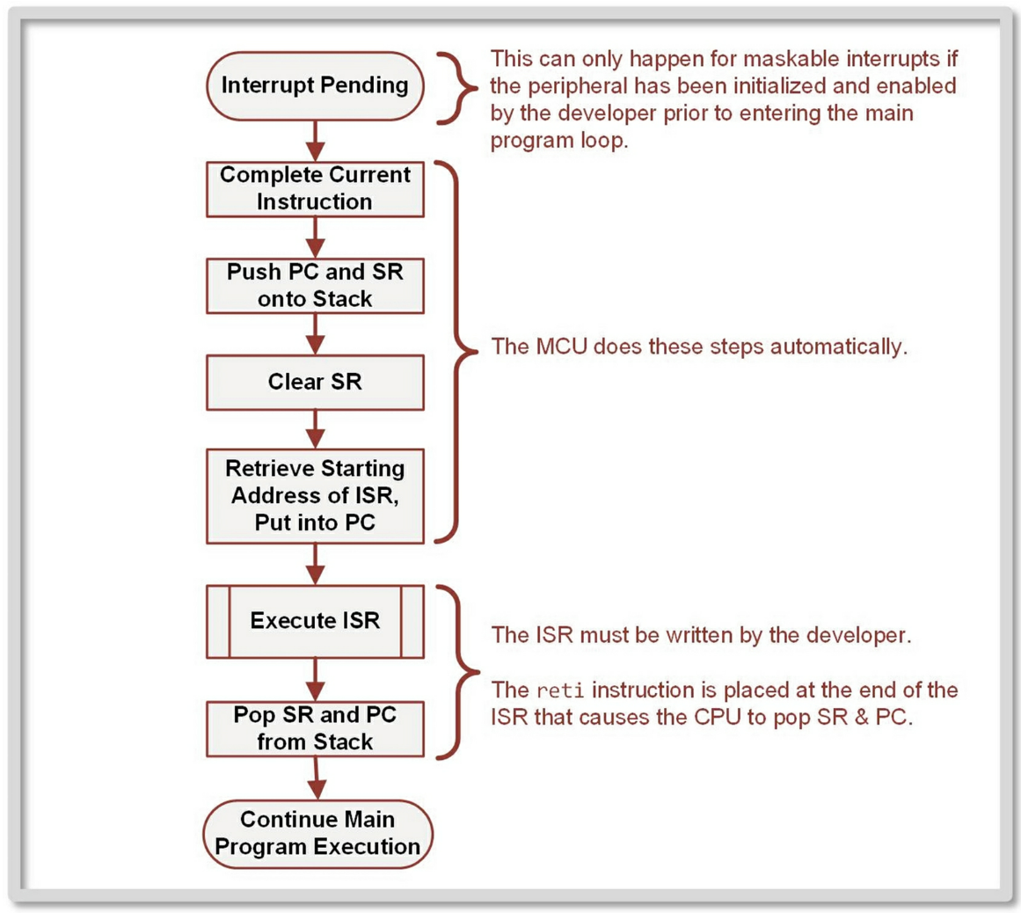
Interrupt Servicing Summary

Slide 44
Nested Interrupts
As mentioned earlier, another one of the automatic steps that is accomplished by the interrupt system is to clear SR before entering the ISR.
This means that maskable interrupts are disabled while executing an ISR because GIE = 0.
Once the ISR completes and the SR is popped off the stack, the original value of GIE = 1 is restored and maskable interrupts are again enabled when the CPU returns to the main program.
System resets and non-maskable interrupts can always interrupt other lower priority ISRs because they are not enabled by GIE. This is by design because system resets and non-maskable interrupts are high priority events that must be serviced immediately to ensure the proper operation of the MCU and/or prevent damage to the device.
If it is desired to allow a maskable interrupt to interrupt another maskable IRQ, then the developer must explicitly set the GIE bit within the ISR.
Creating nested ISRs is not recommended because it can lead to stack overflow or infinite ISR loops.

Slide 45
When using maskable interrupts, it is important to keep in mind which tasks are taken care of automatically by the MCU and those that the developer must do.
When using a specific peripheral with a maskable interrupt, the developer has the following responsibilities: Configure the peripheral for the desired functionality. Clear the peripheral’s interrupt flag (IFG).
Assert the local interrupt enable (IE) for the peripheral. Assert the global interrupt enable (GIE) in the status register. Write the ISR with an address label to mark its starting location and the reti instruction to denote its end.
Remember that the ISR must clear the peripherals local interrupt flag (IFG) so that when the ISR completes, the peripheral doesn’t inadvertently trigger another IRQ. Initialize the vector address for the peripheral using the ISR address label and assembler directives.

Slide 46
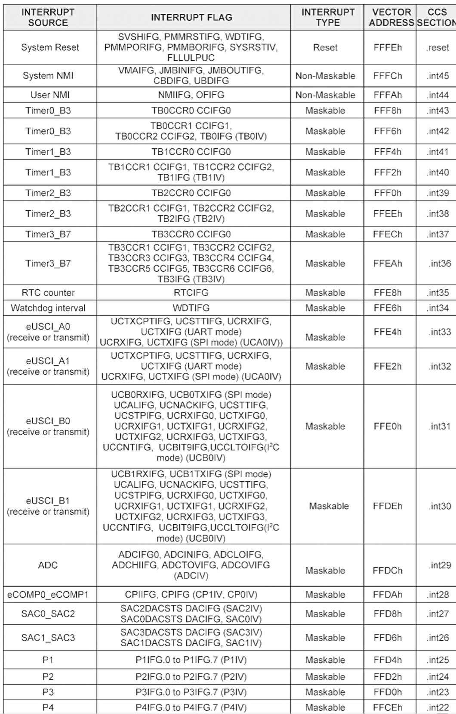

Slide 47
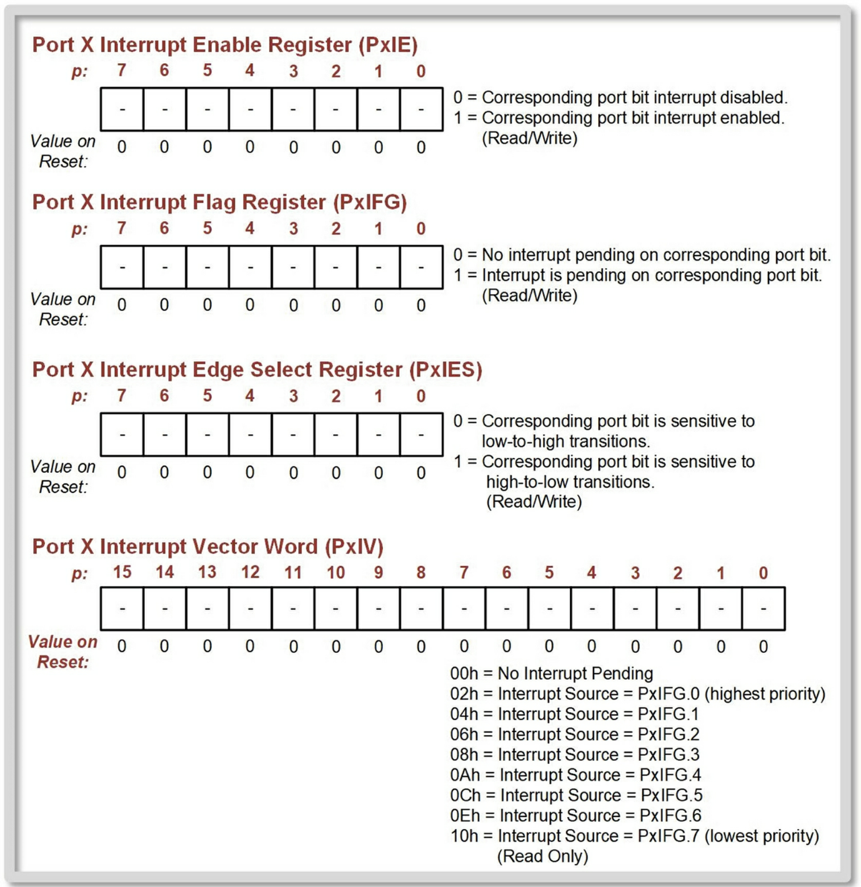

Slide 48
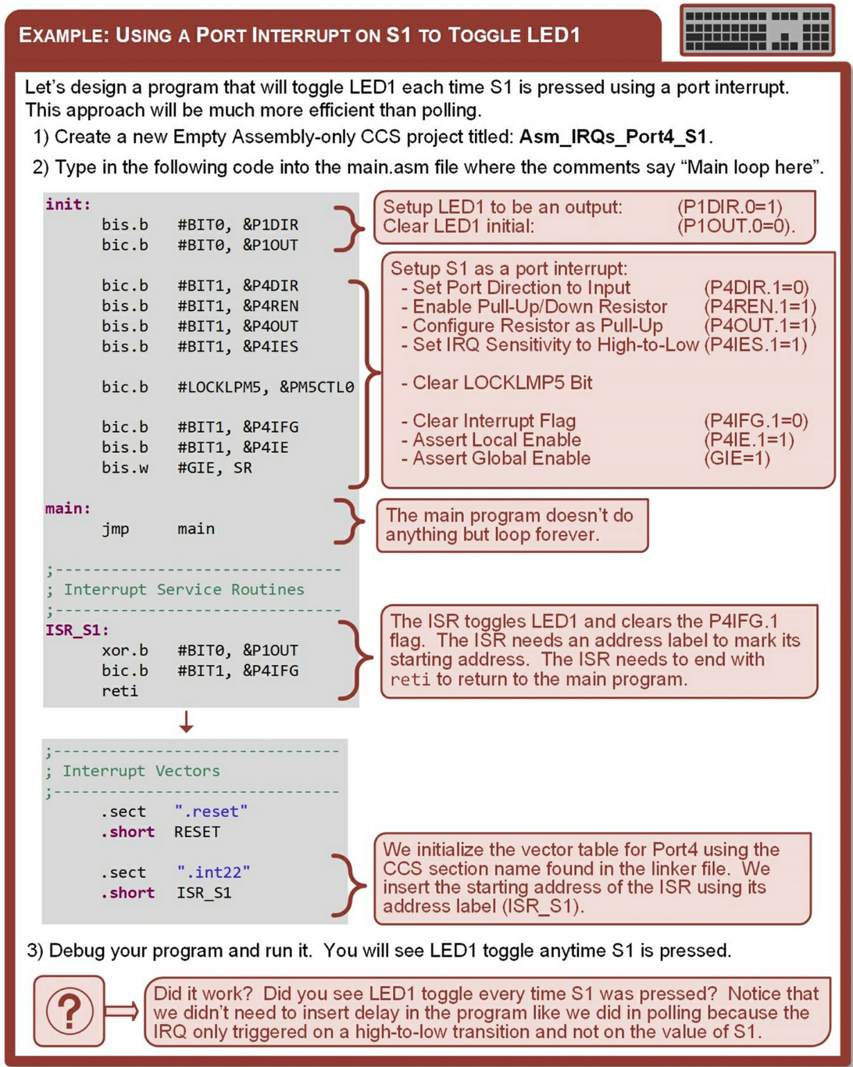

Slide 49
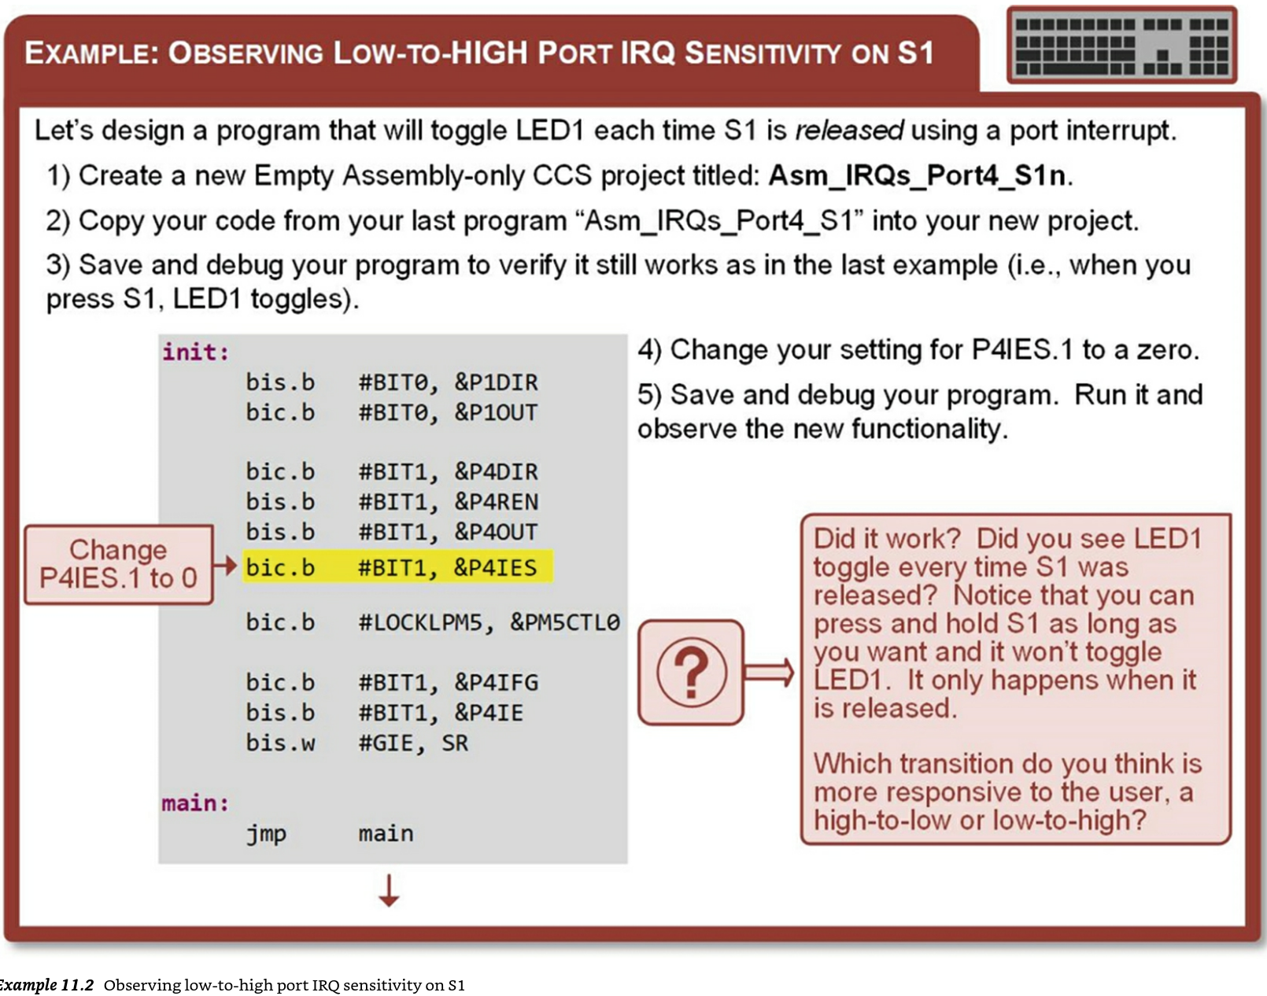

Slide 50
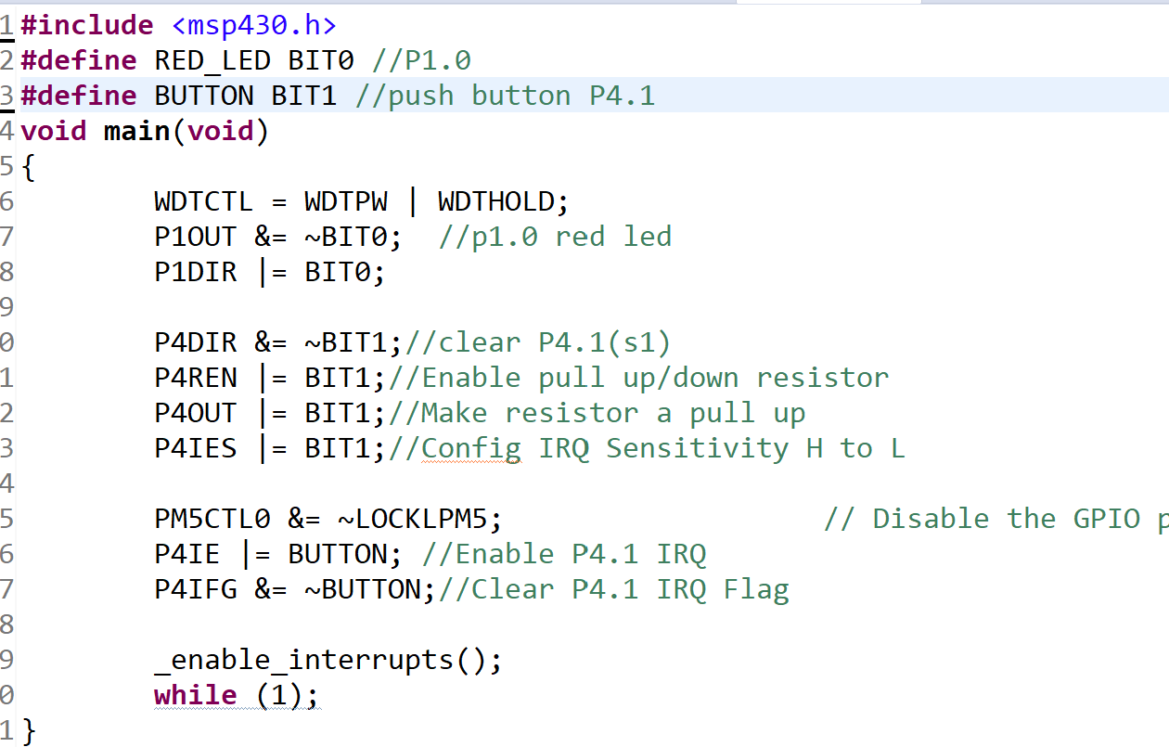
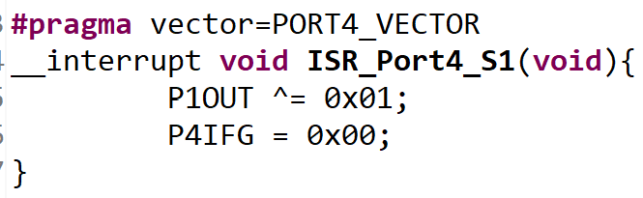
Writing a program that can be interrupted by interrupt I, generic interrupt for MSP430

Slide 51
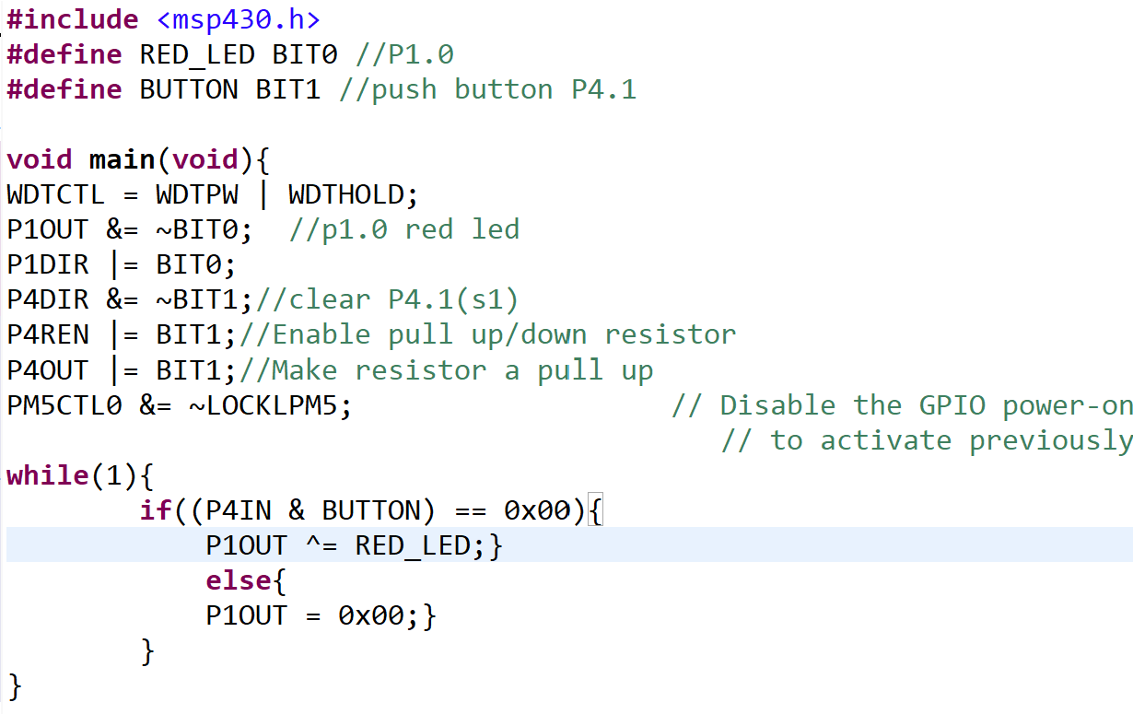
Writing a program that can be interrupted by interrupt I, generic interrupt for MSP430

Slide 52
Maskable Interrupt Example
Design an MSP430 interrupt-based system that outputs a random 8 bit to 8 LEDs on P2 every time a normally-closed push button on P4.0 is pressed.
#include <msp430.h>
void main(void){
WDTCTL = WDTPW|WDTHOLD;
int cnt = 0;
P1DIR |= BIT0;
P2DIR |= 0xFF;
P4REN |= BIT0;
P1OUT &= ~BIT0;
P4IE |= BIT0;
P4IES &= ~BIT0;
P4FG &= ~BIT0;
_enable_interrupts();
while(1){
cnt++;}
}
#pragma vector = PORT1_VECTOR
__interrupt void PORT1_ISR(void) {
P1OUT = cnt;
P1IFG &= ~BIT0;
}

Slide 53
Non-Maskable Interrupt Example (redoing the previous one
#include <msp430.h>
void main(void){
WDTCTL = WDTPW|WDTHOLD|WDTNMI;
int cnt = 0;
P1DIR |= BIT0;
P2DIR |= 0xFF;
P1REN |= BIT0;
P1OUT &= ~BIT0;
IE1= NMIE;
IFG1&= ~NMIFG;
_enable_interrupts();
while(1){
cnt++;}
}
#pragma vector = NMI_VECTOR
__interrupt void NMI_ISR(void)
{
P1OUT = cnt;
IIFG1 &= ~NMIFG;
IE1 = NMIE;
}

Slide 54
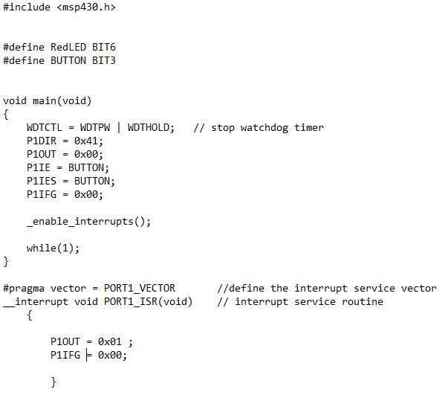
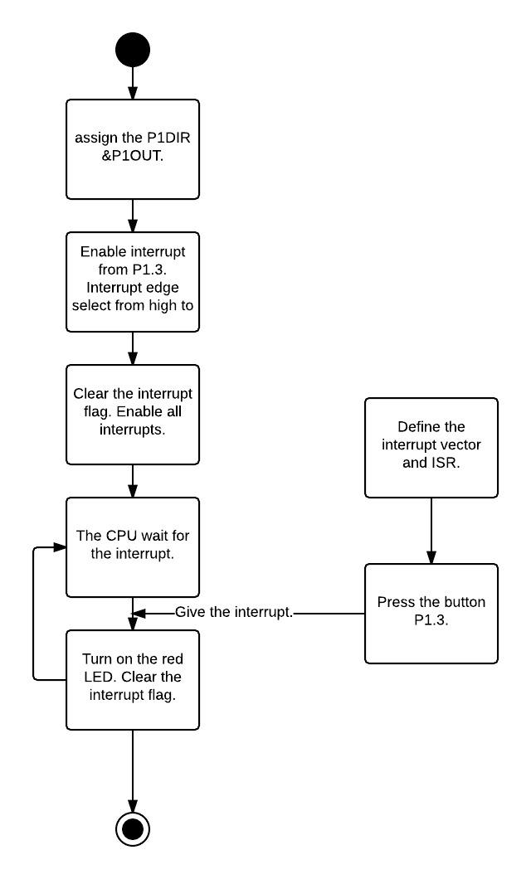
Turn on the red LED

Slide 55
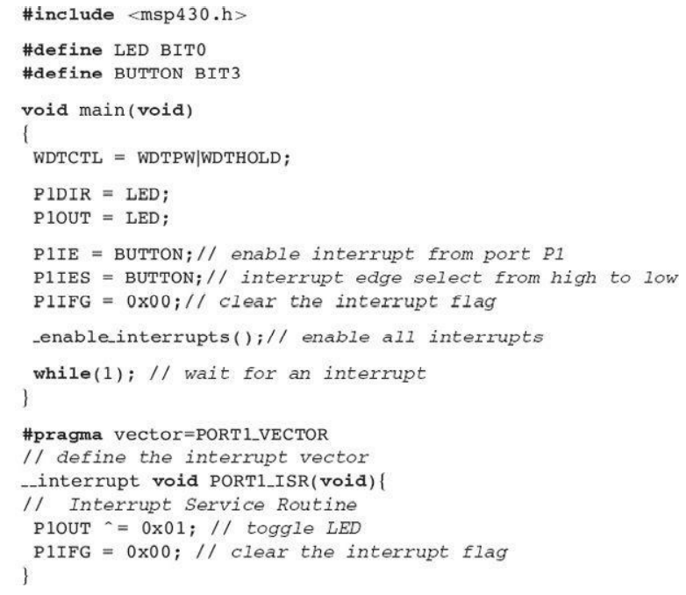
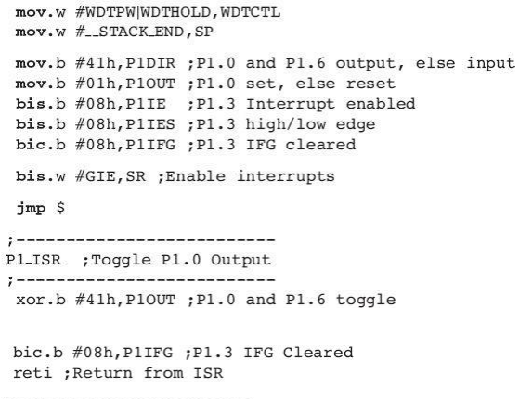
C and Assembly
Example: Toggle the red LED
Example: Toggle the red and Green LED

Slide 56
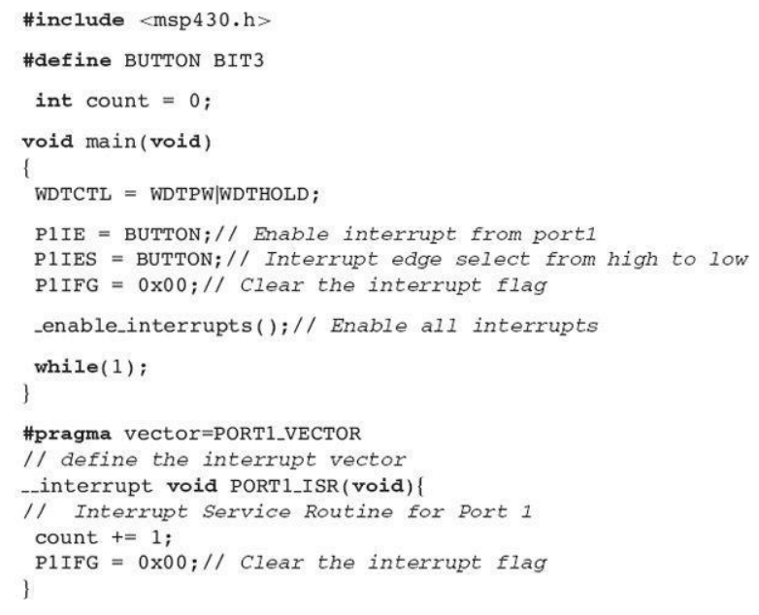

Count the number of button presses by interrupts

Slide 57

Count the number of button presses by interrupts
bis.b #08h,P1IE
bis.b #08h,P1IES
bic.b #08h,P1IFG
clr R5
bis.w #GIE,SR
jmp $
;-------------------
P1_ISR
;-------------------
inc R5
bic.b #08h,P1IFG
reti

Slide 58
Turn on and off LEDs by the total number of interrupts
#include<msp430.h>
#define REDLED BIT0
#define GREENLED BIT6
#define BUTTON BIT3
int count=0;
void main(void) {
WDTCTL=WDTPW|WDTHOLD;
P1DIR=REDLED|GREENLED;
P1OUT=0x00;
P1IE=BUTTON;
P1IES=BUTTON;
P1IFG=0x00;
_enable_interrupts();
while(1);
}
#pragma vector=PORT1_VECTOR
__interrupt void PORT1_ISR(void){
count++;
if(count==4)
P1OUT=REDLED;
if(count==6){
P1OUT=0x00;
P1OUT=GREENLED;
count=0;
}
P1IFG=0x00;
}
When count = 4, Red led will be on
When count = 6, Green led will be on
Draw the UML diagram

Slide 59
Test the code
#include <msp430.h>
#define RedLED BIT6
#define GreenLED BIT0
#define BUTTON BIT3
int count = 0;
int div = 0;
void main(void)
{
WDTCTL = WDTPW | WDTHOLD; // stop watchdog timer
P1DIR = 0x41;
P1OUT = 0x00;
P1IE = BUTTON;
P1IES = BUTTON;
P1IFG = 0x00;
_enable_interrupts();
while(1);
}
#pragma vector = PORT1_VECTOR //define the interrupt service vector
__interrupt void PORT1_ISR(void) // interrupt service routine
{ count++;
if(count ==6|| count ==12|| count ==18)
P1OUT = GreenLED;
else {
P1OUT = RedLED ;
}
P1IFG = 0x00;
///__delay_cycles(5000);
}
Show the P1 and SR registers values before and after interrupts

Slide 60
Advantages of interrupts (Using low power mode)
#define RedLED BIT0
#define Button BIT3
int main(void)
{
WDTCTL = WDTPW | WDTHOLD;// stop watchdog timer
P1DIR = RedLED;
P1OUT = 0x00;
P1IE = Button;
P1IES = Button;
P1IFG = 0x00;
_enable_interrupts();
LPM4;
}
#pragma vector=PORT1_VECTOR
__interrupt void PORT1_ISR(void){
P1OUT = RedLED;
BCSCTL3 |= LFXT1S_2;
WDTCTL = WDT_ARST_1000;
P1IFG = 0x00;
}
Test the code
This low power will be taught in chapter 10 (oscillators, clock, timers)
Show the P1 and SR registers values before and after interrupts

Slide 61

Create a UML diagram that describes the process of making a right turn at a 4 –way intersection that has a traffic light.
A right turn can be made on RED
The traffic light also has a right-turn arrow
Assumptions: no pedestrians present
Turn on right turn signal (action)
Approach intersection slowly (action)
Check the color of the light (decision)
A. If green, make right turn
B. If red
Make complete stop
Wait for other cars to pass
Return to check for cars
If no car, make right turns

Slide 62

Interrupts in C

Slide 63


Slide 64
Summary
Interrupts provide a way to efficiently deal with peripherals that are asynchronous to the CPU and slower than the CPU clock. When an interrupt occurs, it asserts a flag and waits to be serviced by the CPU. While waiting for the CPU to respond to it, the interrupt is said to be pending. The CPU will service an interrupt only after it finishes executing its current instruction. When the interrupt is serviced, the CPU stops execution of the main program and instead executes an interrupt service routine that is dedicated to the peripheral that triggered the IRQ.

Slide 65
Summary
Interrupts are prioritized in terms of their importance. When a CPU is ready to service an IRQ, it handles the highest priority first. Multiple IRQs can be pending at once. There are three classes of interrupts: system resets, non-maskable interrupts, and maskable interrupts. System resets are the highest interrupt. They do not have developer written ISR; instead, they initialize all configuration registers to their default values and insert the starting address of the main program into PC. Non-maskable interrupts are the next highest priority interrupts. These handle memory access or oscillator faults. They also handle a user interrupt that can come from an external signal.

Slide 66
Summary
NMIs are always enabled and execute a developer written ISR. Maskable interrupts have a local and global enable. The local enable is unique to each feature of each peripheral that can trigger and interrupt. The global interrupt is the GIE bit in the SR. For an interrupt to be active, it must have both its local enable and GIE asserted. The starting address of an ISR is put into its interrupt vector address. The interrupt vectors reside at dedicated addresses reserved at the end of program memory. The starting address of the ISR is placed into the vector location using assembler directives and the address label of the start of the ISR. When an IRQ occurs, the CPU automatically pushes the PC and SR onto the stack to preserve the operation of the main program. At the end of an ISR, the developer must use the reti instruction to pop SR and PC off the stack to return execution to the main program. Interrupts can interrupt other interrupts. Since system resets and NMIs are always enabled, they can interrupt each other with higher priority IRQs being able to interrupt lower priority IRQs. When a maskable interrupt occurs, the CPU automatically clears SR, disabling other maskable interrupts.

Slide 67
Summary
If a developer wishes to allow nested maskable interrupts, they need to explicitly set the GIE bit in the ISR. A better approach is to write short ISRs and allow the IRQ prioritization scheme handle the order the ISRs are executed. When an IRQ is served, the MCU completes the current instruction, pushes the PC and SR to the stack, clears the SR, retrieves the starting address of the ISR from the vector table, executes the ISR, then pops SR and PC off the stack to return to normal execution in the main program. The MSP430FR2355 implements 25 unique interrupt vectors. Each vector is associated with multiple flags. If multiple peripheral features are enabled and share the same vector address, it is the job of the developer to determine which flag caused the IRQ within the ISR. A port interrupt is an IRQ that is triggered when there is an input transition observed on a bit of a port. This allows external signals to be handled more efficiently compared to polling. Each bit within ports 1➔4 can trigger an interrupt; however, each port only has one unique vector address. Port interrupts are configured using the PxIFG, PxIES, PxIE, and PxIV (optional) registers. To use a port interrupt, the pin must also be configured as an input with an optional pull-up/down resistor.

